Slide 1

Applications of Number System
Exploring real-world uses of number systems in digital technologies.

Slide 2
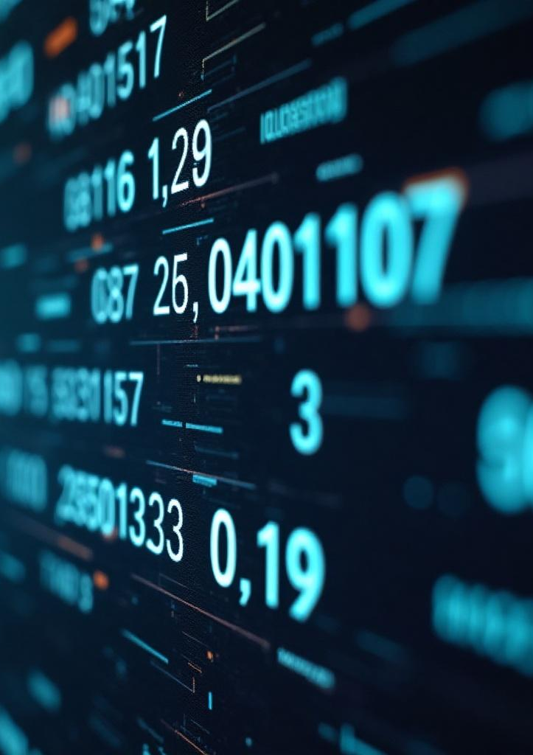
Introduction

Slide 3

01
Number System Applications

Slide 4
Binary System in Programming
The binary number system, comprising only 0s and 1s, is foundational to all machine-level instructions in computers. This is because digital electronics operate in two states: on (1) and off (0). High-level programming languages are ultimately translated into binary code, which is processed by the computer's hardware to execute tasks.

Slide 5

IP Addressing in Networking
In networking, IP addressing utilizes the binary system to uniquely identify devices connected to the internet. For instance, IPv4 addresses use a 32-bit binary format, such as 192.168.1.1. Routers and switches rely on these binary addresses to facilitate accurate data routing across networks, ensuring that information reaches its designated destination.

Slide 6
Digital Storage Calculation
Digital storage is primarily quantified using the binary number system, where data is measured in units based on powers of 2. For instance, 1 kilobyte (KB) equals 1024 bytes, 1 megabyte (MB) equals 1024 kilobytes, and so on. This binary structure arises from the electronic signaling capabilities of digital circuits, which allows precise and efficient data storage and retrieval.

Slide 7

02
Digital Media Codes

Slide 8
Color Codes in Digital Media
In the realm of digital media, color representation is often achieved through numerical codes, with hexadecimal being a common format. Hexadecimal color codes, such as #FF5733, represent RGB (Red, Green, Blue) color values, allowing for a wide spectrum of colors to be accurately displayed on screens. This compact coding system facilitates easier integration into web design and digital graphics.

Slide 9
Barcode and QR Code Encoding
Barcodes and QR codes are crucial in the encoding of product information. These codes utilize binary representations to store data that can be quickly scanned and processed by devices. When scanned, a barcode or QR code translates the visually encoded binary into readable information, enabling efficient product identification and tracking within logistics and retail systems.

Slide 10
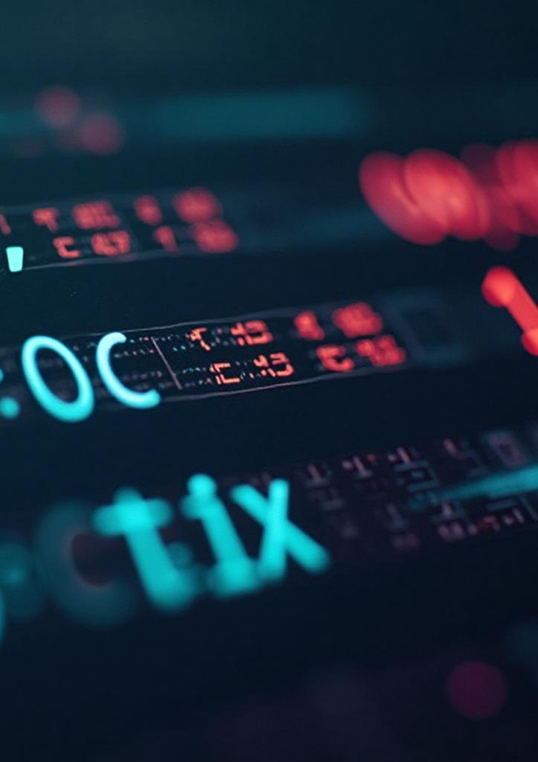
Hexadecimal Representation
Hexadecimal representation provides a streamlined way to express binary data. By grouping binary digits into sets of four, one can convert binary numbers into a corresponding hexadecimal code, making it simpler to read and interpret. This format is extensively utilized in programming and digital applications, facilitating efficient manipulation of data, including memory addresses and color values.

Slide 11
Conclusions
The number system plays an integral role in various digital applications, from programming to data representation. Understanding how these systems operate enhances our ability to utilize technology effectively, paving the way for advancements in digital communication, storage, and media representation.

Slide 12
Thank you!
Do you have any questions?
www.yourwebsite.com
+00 000 000 000

